Slide 1


<Image Understanding of GUI Widgets for Test Reuse>
By
<20BCE2901> < Prajwal Lamsal>
<20BCE2773> <Yash Mishra>
<20BCE2921> <Prithak Gajurel>
Under the Guidance of
<Dr. Swarnalatha. P>
School of Computer Science and Engineering
Replace this picture with Graphical Abstract that reflects your title
Sample:
http://www.elsevier.com/graphicalabstracts

Slide 2
Scope
The scope of this topic is broad and encompasses various aspects of computer science and software engineering. One key area of focus is computer vision, which involves developing algorithms and techniques for analyzing and understanding visual data, such as images and videos. In the context of GUI test reuse, computer vision can be used to automatically recognize and match GUI widgets across different applications.
Another important area of focus is deep learning, which is a subfield of machine learning that involves training artificial neural networks to perform complex tasks, such as image recognition and natural language processing. In the context of GUI test reuse, deep learning techniques can be used to train models that can automatically identify and match semantically similar GUI widgets.
Finally, the scope of GUI testing is also relevant to this topic, as it involves developing techniques and tools for testing graphical user interfaces. In the context of GUI test reuse, this includes the development of methods and algorithms for automatically generating test cases for GUI applications based on existing test cases from other applications. Overall, the scope of image understanding of GUI widgets for test reuse is an interdisciplinary field that involves computer vision, deep learning, and GUI testing to improve the efficiency and effectiveness of software testing.

Slide 3
Objectives
To develop algorithms and techniques for automatically recognizing and matching GUI widgets across different applications, which can help in reusing existing test cases for new applications.
To investigate the use of deep learning techniques for automatically identifying semantically similar GUI widgets across different applications, which can help in generating more meaningful and effective test cases.
To improve the efficiency and effectiveness of GUI testing by developing methods for automatically generating test cases based on existing test cases from other applications.
To address the limitations of current GUI test generators, which often generate semantically meaningless GUI tests that miss many relevant behaviors of the application under test.
To explore the reuse of GUI tests across similar applications as an alternative way to automatically generate GUI tests, which can help in generating semantically meaningful GUI tests that properly exercise the functionalities of the target

Slide 4
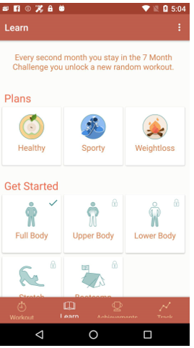
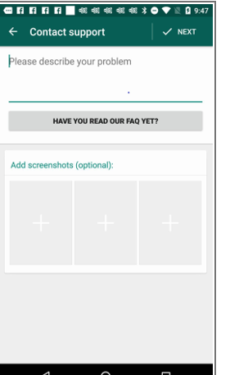
Requirements Specifications
Software Specifications
The major components of the system are the dataset used and the framework used for judging the different approaches for suggesting GUI test transfer from one trace of events to another. The dataset used is ‘Rico: A Mobile App Dataset for Building Data-Driven Design Applications’[1]. It possesses over 70000 unique UI screens from over 9300 apps. It has defined traces for different UI events. It has also provided semantic annotations to all the GUI elements present in the UI screens along with json files describing the hierarchical relation between the objects. All of these features make it ideal for use

Slide 5
Specifications
Figure 1: Example of semantic annotation of UI Screen in Rico dataset.
The other component of the system is the framework used in [2]. The framework analyzes the usage of ATM and CraftDroid for test transfer and also proposes a custom algorithm called SemFinder which tries to perform the same task by taking the help of semantic matching of GUI events. The framework was obtained online at [3]. The framework and dataset are implemented using python on Google Colab.

Slide 6
Process Model of the System
The previous work on semantic matching for GUI event test transfer discusses semantic annotation based only on text. However, including the semantic annotations of GUI widgets and icons could probably boost the performance of certain techniques. The main objective of this work is to integrate semantic annotations of GUI widgets into the existing system for judging the variation in performance caused by it.
Dataset
The Rico dataset[1] has a wide array of data samples of UI screenshots and related information such as trace of events, UI layout vectors, semantic annotations and descriptions of hierarchical relationships. The presence of these features in the dataset is essential for the task as information regarding different UI elements need to be collected step-wise as per the trace of the event. Also the semantic annotation of icons and widgets allows for easy integration of semantics of images.
Extraction of data
The relevant data was extracted from the dataset. Essential data (event_index, label, type) as well as optional data (text, id, content_desc, hint, parent_text, sibling_text, activity,atm_neighbor, file_name) were all taken from the dataset via mining of the dataset. The extraction of relevant data from the dataset is a critical step in data mining and is essential for obtaining meaningful insights and patterns from the data. By selecting essential data such as event_index, label, and type, the extracted data can be used for a variety of purposes, such as training machine learning models, detecting anomalies, and understanding user behavior.

Slide 7
Process Model of the system
III. Semantic Matching Framework
The model provided at [3] has readily been trained on various state of the art models like GLOVE, word2vec and so on. The same framework was utilized for testing the earlier obtained data as well after it was adjusted into suitable input format. The framework judged the performance of semantic matching of different events by the different test migration algorithm, descriptor algorithm, training set that was used to train the model and word embedding model.
The use of state-of-the-art models like GLOVE and word2vec in the training of the model provides a solid foundation for semantic matching of different events. By leveraging pre-trained word embeddings, the model can capture the semantic similarity between textual information of GUI widgets, enabling effective transfer of human-designed GUI tests from a source application to a target application with similar functionalities.
The testing of the earlier obtained data after adjustment into a suitable input format provides valuable insights into the performance of the framework. By evaluating the performance of semantic matching using different test migration algorithms, descriptor algorithms, training sets, and word embedding models, it becomes possible to identify the best approach for specific use cases.
The framework presented in [3] provides a robust and flexible solution for UI test reuse, leveraging state-of-the-art models and algorithms to achieve high accuracy in semantic matching. The insights gained from the evaluation of the framework can be applied to various domains, improving the efficiency and effectiveness of UI testing in software development.
IV Evaluation Metrics
Mean Reciprocal Rank (MRR) has been used for evaluation as a metric which has been used in [2] as well. The advantage of using MRR as an evaluation metric is that it takes into account the order of the results, rather than just whether or not the relevant item was present in the list. In other words, MRR rewards algorithms that place relevant items at the top of the list, and penalizes algorithms that bury relevant items lower down in the list.

Slide 8
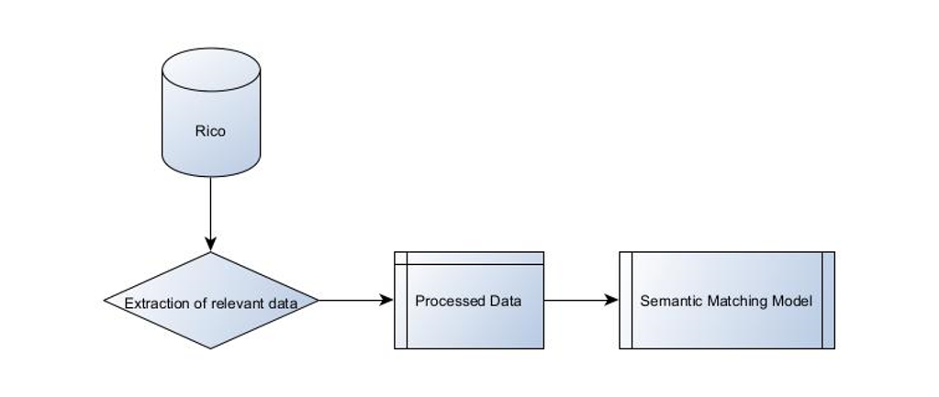
Block diagram of the System

Slide 9
Normans 7 principles
Sure, here are the Norman's 7 principles of interaction design, which are applicable to various fields including GUI design:
1.Visibility
The system have always keep users informed about what is going on,the needs and consistent has been transparent through appropriate feedback within a reasonable amount of time.
For example, the visibility principle is applied by providing appropriate feedback to the user as they interact with the system, such as showing the status of the test being generated or indicating when a test is complete.
2.Feedback
The system has always provides feedback to users and the stakeholder about their actions and the state and premilaniry of the system. It give users clear and concise information about their actions and the state of the system, such as indicating which test cases have already been created.
3.Affordance
The system have made it clear what actions are possible through the design of the interface, providing appropriate clues as to how the interface should be used.It helped users understand what actions are possible by designing the GUI widgets in a way that makes it clear how they can be used
4.Consistency
The system is particularly consistent, both within itself and with other similar systems, like other state systems in terms of design, functionality, and operation throughout the analysis.It ensured that the GUI widgets are similar in design and function to other systems, which can help users understand how to interact with them.

Slide 10
t
5.Mapping
The relationship between the elements of the system and the real world has been made clear and understandable to the user, to help users understand how to interact with the system.It is applied by using metaphors or visual cues that help users understand how to use the GUI widgets, such as using icons or labels that clearly indicate their purpose
6.Constraints
The system has limit the possible actions that can be taken to help prevent errors and misunderstandings
It is used to limit the possible actions that can be taken to prevent errors or misunderstandings, such as disabling certain options that are not applicable to the current state of the system.
7.Simplification
The system has made the interaction as simple and straightforward as possible, minimizing the cognitive load on the user and reducing the potential for errors.
It help reduce the cognitive load on the user by making the interaction as simple and straightforward as possible, such as by minimizing the number of steps required to create a test case or providing clear and concise instructions. By applying these principles, designers can create a user-friendly and effective system for generating test cases using GUI widgets.
These principles can be applied to the design and implementation of GUI widgets for test reuse, to ensure that the resulting system is user-friendly, easy to use, and effective in generating meaningful and effective test cases.

Slide 11
Nielsens 10 Heuristics Evalauation:
1.Visibility of system status
Keep users informed about what is going on, through appropriate feedback within a reasonable amount of time.
It is used to ensure that the user is always informed about the status of the system, such as showing the progress of a test generation process.
2.Match between system and the real world
The system have spoke the users' language, with words, phrases and concepts familiar to the user, rather than system-oriented terms.The match between system and the real world heuristic can be applied by using familiar and consistent design elements in the GUI widgets, such as using icons that are easily recognizable by the user
3.User control and freedom
Users often choose system functions by mistake and will need a clearly marked "emergency exit" to leave the unwanted state without having to go through an extended dialogue. It can be used to allow users to undo or redo actions, to provide an emergency exit or cancel button, or to allow users to easily navigate between different stages of the test generation process
4.Consistency and standards
Users should not have to wonder whether different words, situations, or actions mean the same thing. Follow platform conventions.
The consistency and standards heuristic can be used to ensure that the design and functionality of the GUI widgets are consistent with other similar systems or industry standards.
5.Error prevention:
Even better than good error messages is a careful design which prevents a problem from occurring in the first place.
The error prevention heuristic can be used to design the GUI widgets in a way that prevents errors from occurring, such as by providing appropriate error messages when input is incorrect or by limiting the possible actions that can be taken to prevent misunderstandings

Slide 12
m
6.Recognition rather than recall
Minimize the user's memory load by making objects, actions, and options visible. The user should not have to remember information from one part of the dialogue to another.This heuristic recommends minimizing the user's memory load by making objects, actions, and options visible This can be achieved by providing clear and concise labeling and using familiar icons and symbols.
7.Flexibility and efficiency of use
Accelerators -- unseen by the novice user -- may often speed up the interaction for the expert user such that the system can cater to both inexperienced and experienced users. It suggests that the system should cater to both inexperienced and experienced users by providing shortcuts or accelerators that speed up the interaction for expert users without overwhelming or confusing novice users. This can improve overall efficiency and user satisfaction.
8.Aesthetic and minimalist design
Dialogues should not contain information which is irrelevant or rarely needed. Every extra unit of information in a dialogue competes with the relevant units of information and diminishes their relative visibility. It emphasizes the importance of avoiding clutter and keeping dialogues as simple and minimal as possible. By removing unnecessary information, users can focus on the most relevant and important information, reducing the cognitive load required to complete a task.
9.Help users recognize, diagnose, and recover from errors: Error messages should be expressed in plain language (no codes), precisely indicate the problem, and constructively suggest a solution.Error messages should be clear and specific, using plain language to help users understand what went wrong and how to fix it. Constructive suggestions for resolving the issue can also be provided to help users recover quickly.
10.Help and documentation:
Even though it is better if the system can be used without documentation, it may be necessary to provide help and documentation. Any such information should be easy to search, focused on the user's task, list concrete steps to be carried out, and not be too large.

Slide 13
Cognitive Walkthrough
1.Identify the tasks: Identify the tasks that the users are likely to perform using the GUI widgets for test reuse. For instance, tasks may include selecting an image, adding annotations, and saving the annotated image.
2.Create a user profile: Develop a user profile that represents the typical user who will use the GUI widgets for test reuse. This profile should include demographic characteristics, user goals, and task-specific knowledge.
3.Walkthrough the interface: Step through each task in the interface, one at a time. As you do so, assume the role of the user and ask yourself the following questions:
(a)Will the user know what to do at this point?
(b)Will the user understand the purpose of this action?
(c)Will the user be able to tell if the action was successful or not?
4.Evaluate the results: Evaluate the results of the walkthrough and identify any potential issues or areas of confusion that the user may experience. e)e)e)Consider the cognitive load on the user, and determine if the interface provides appropriate feedback and affordances to assist the user.
5.Address the issues: Address the issues identified during the walkthrough by modifying the GUI widget design. Consider alternative ways to present the information or actions, improve the affordances or feedback, and simplify the interface to reduce cognitive load.
6.Test the updated interface: Test the updated interface to ensure that the issues identified during the walkthrough have been resolved, and that the interface is now more user-friendly and effective for image understanding using GUI widgets for test reuse.

Slide 14
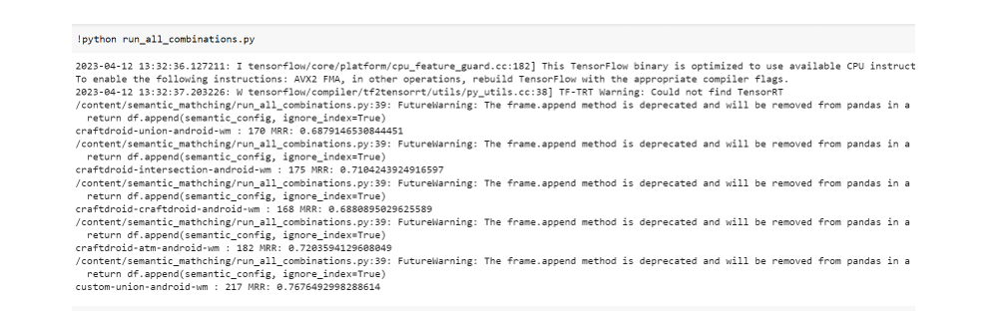
Results
Snaps of output

Slide 15
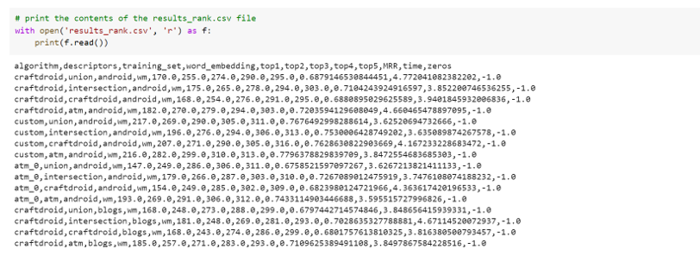
s
Figure 3: Sample output of the system

Slide 16
Conclusion
In conclusion, UI testing is a crucial but expensive activity in software development. Test reuse approaches have emerged as a promising solution to reduce the cost of UI testing, but the success of these approaches relies heavily on the semantic matching of GUI events. The integration of semantic annotation of icons, widgets, and images can enhance the accuracy of semantic matching, and also improve the interpretability and maintainability of UI tests. This approach has the potential to reduce the overall cost and effort required for UI testing and improve the quality of software by enabling more comprehensive testing. These findings offer practical insights for software developers and researchers, highlighting the importance of image understanding of GUI widgets in test reuse.
Identifying and eliminating inconsequential and contradictory data automatically is an essential task that requires attention in the future. Also the potential of image understanding and semantic matching needs to be further explored to yield better results in the future for this field.

Slide 17
Implementation [ Demo ]
Implementation/Survey/Comparison – [Demo]/

Slide 18
PAPER STATUS - COMMUNICATED/ACCEPTED/PUBLISHED
PAPER STATUS WITH PLAGIARISM REPORT USING WHICH TOOL

Slide 19
Paper IEEE Template
Title of the Paper
Authors Name(Students + Mentor Name)
Keywords
Introduction
LIterature survey
Methodology
Comparative study (if any)
Results and Discussion
Conclusion
References
Appendix (if any)
Biography (Authors)
No. of Pages (Min 10 to 20 pages)
Plagiaraism Report( <=12 % )- Any open source tool
Paper Communication Details
(ex: submitted/accepted/published)

Slide 20


